Slide 1


SUSTAINABLE AGRICULTURE WITH AI FOR CROP YIELD PREDICTION
S4F_CP_Team_12189

Slide 2
Content
Abstract
Problem Statement
Objective
Data Collection and Preparation
Proposed Solution (Methodology)
Model Performance Evaluation
Screenshots / Demonstration (video)
Future Scope
Conclusion
Notes:
Abstract
Problem Statement (Clearly define the challenge)
Objective (State your project's goal)
Background and Research (Discuss existing solutions, trends, and gaps)
Data Collection and Preparation (Focus on data sources, cleaning, and augmentation)
Proposed Solution (Methodology)
Model Architecture (e.g., CNN, U-Net, YOLOv5)
Key Techniques (e.g., Transfer Learning, Image Augmentation)
Model Performance Evaluation
Metrics (Accuracy, Precision, Recall, IoU, etc.)
Graphs (Confusion Matrix, ROC Curve, etc.)
Screenshots / Demonstration (Visual proof of system functionality)
Future Scope (Improvements, scalability, and integration ideas)
Conclusion (Summarize results and impact)
Q&A Session

Slide 3
Abstract
Agriculture is increasingly impacted by climate change and environmental variables.
AI offers solutions for forecasting yields and optimizing resource use.
This study presents an ML approach using environmental data to predict crop yields.
Results show improved efficiency and yield through data-driven decisions.

Slide 4
Problem Statement
Farmers face unpredictable weather, water scarcity, and poor soil conditions.
Traditional yield estimation methods are unreliable.
Climate change exacerbates these challenges.
Need for accurate AI-powered yield predictions.

Slide 5
Objective
Develop an AI model to predict crop yield using environmental data.
Enable informed decisions on irrigation and fertilization.
Reduce environmental impact and increase productivity.

Slide 6
Data Collection and Preparation
Sources: Historical yield data, soil quality indexes, temperature and rainfall data (5 years).
Features: Rainfall, Temperature, Soil Quality.
Steps: Clean data, handle missing values, select relevant features

Slide 7
Proposed Solution (Methodology)
Use a Random Forest Regressor to predict crop yield.
Split data into training and test sets.
Train model on rainfall, temperature, and soil quality data.
Evaluate predictions using MSE and R² score.

Slide 8
Model Performance Evaluation
MSE (Mean Squared Error) and R² score used to measure accuracy.
Scatter plot shows Actual vs Predicted Yield.
Feature importance analysis reveals key influencing factors.

Slide 9
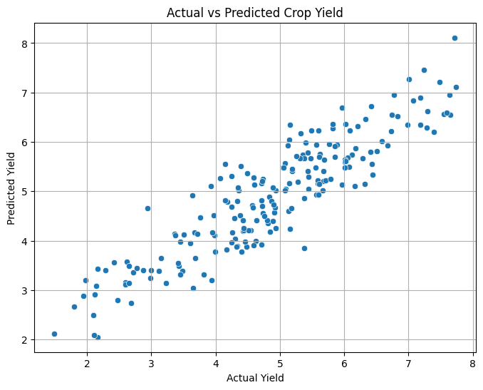
Screenshots
GITHUB : https://github.com/vijay14122004/S4F_CP_Team_12189

Slide 10
Future Scope
Integrate satellite and IoT sensor data for real-time monitoring.
Extend model to include more crop types and regions.
Deploy models on mobile platforms for accessibility in rural areas.

Slide 11
Conclusion
AI can empower farmers with predictive insights.
Helps optimize resources and support sustainable farming.
Potential to improve food security, especially in developing countries.

